Slide 2
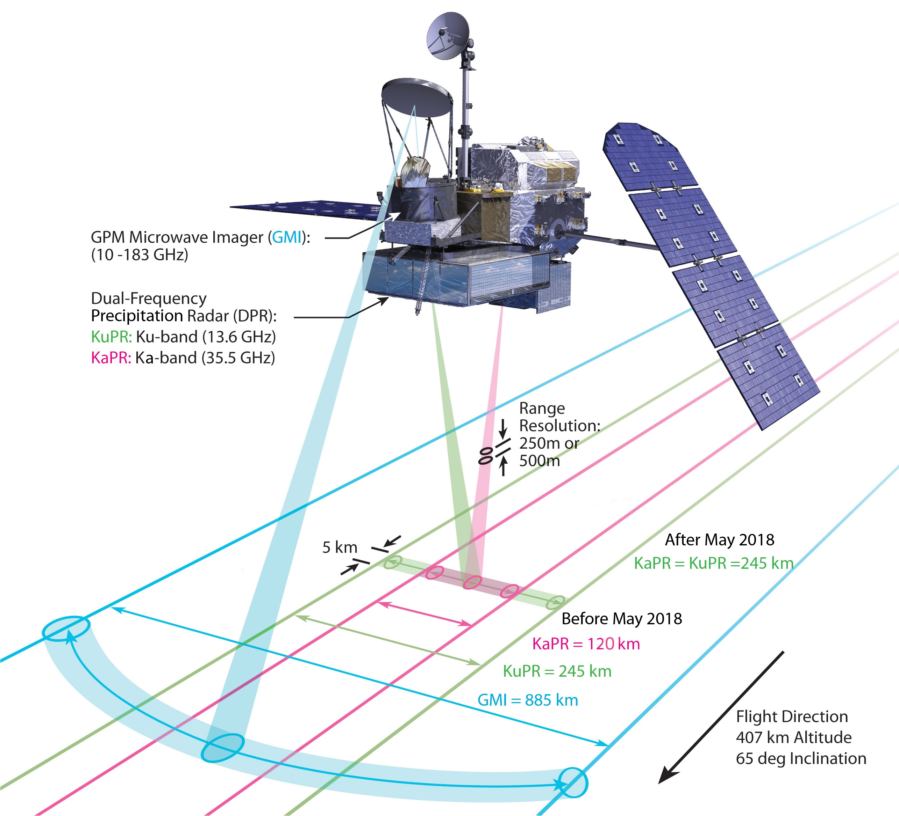

Slide 4
Aggregation
Melting
Breakup
3300 m
dBZ

Slide 5
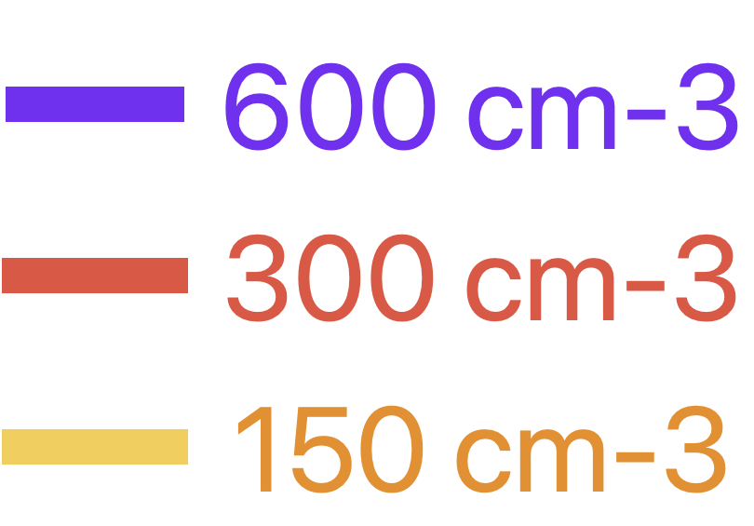
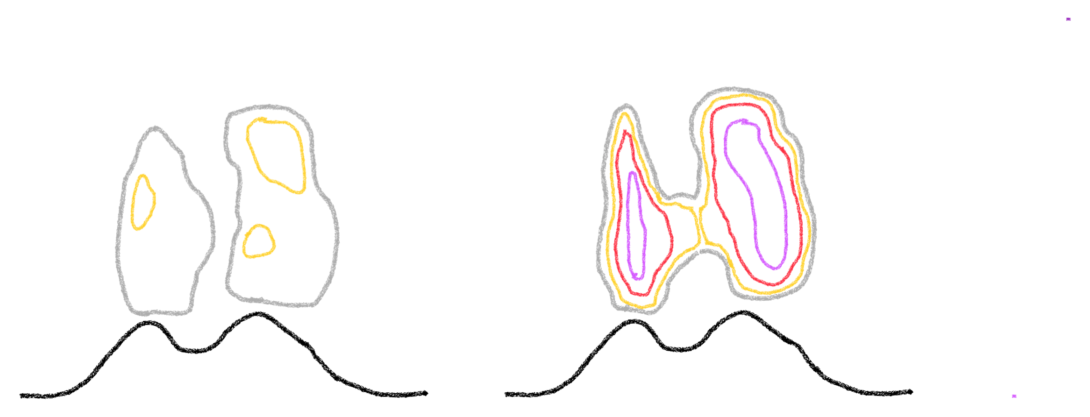
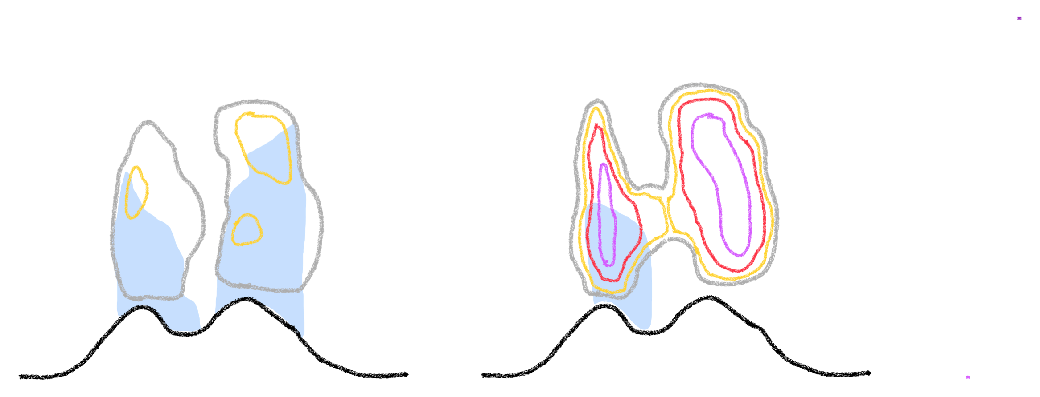
Default Aerosol
Regional Aerosol
CDNC
Lower CDNC
Larger cloud Dm
More rain
Higher CDNC
Smaller cloud Dm Less rain

Slide 6
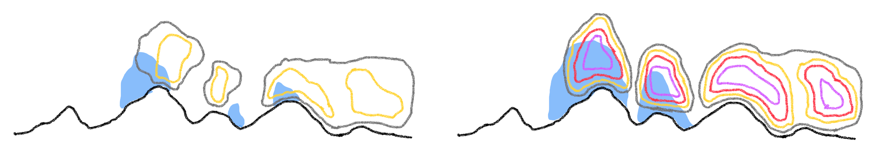
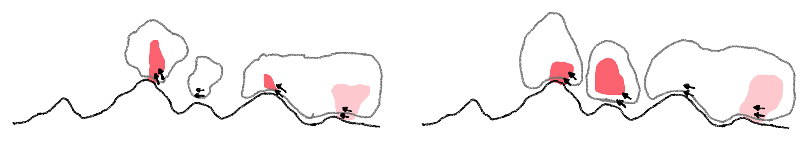
Default Aerosol
Regional Aerosol
CDNC
Lower CDNC
Larger cloud Dm
Less Rain
Higher CDNC
Smaller cloud Dm
More rain
Latent heat released by condensation forced by the impinging flow

Slide 7
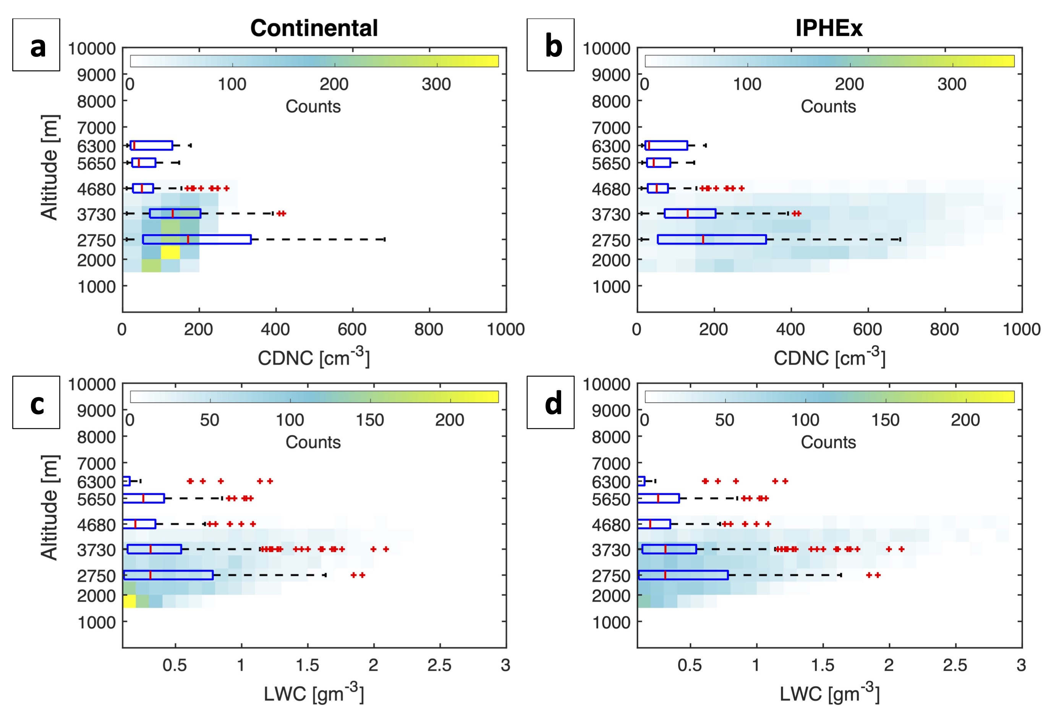
Default Aerosol
Regional Aerosol

